Slide 1
2014 Annual Breast Cancer Rehabilitation
Healthcare Provider Event
A Manual Therapy and Exercise Approach to Breast Cancer Rehabilitation Course
November 7th and 8th, 2014
Mercer University, Atlanta, GA
Sponsored By:
TurningPoint’s Edith Van Riper-HaaseBreast Cancer Rehabiltation Advocacy Fund
Presentations are
Available on TurningPoint’s Website:
myturningpoint.org
Click on Course Link
www.oncologypt.org
itsthejourney.org
thevisualab.com

Slide 2
A Manual Therapy and Exercise Approach to Breast Cancer Rehabilitation Course
Evidence-Based Approach to Lymphedema Evaluation and Management
Overview
Cathy Furbish, PT, DPT, CLT
This Presentation is available on TurningPoint’s Website:
myturningpoint.org
From Homepage Click on Course Link

Slide 3
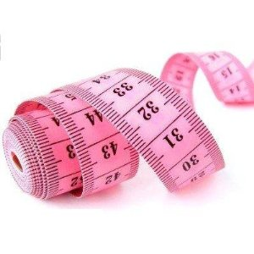
Lymphedema Assessment
Signs and Symptoms
Measurement

Slide 4
No universally accepted diagnostic tool to determine presence of lymphedema
Sensation of heaviness, fatigue, tingling or aching within “at risk” territory in any woman with BC
Circumferential measurements
Bio-impedance Spectroscopy (BIS)
Water displacement
Truncated cone calculation
Optoelectric perometry
Notes:
Patient self-report questionnaire: Norman SA et al. Phys Ther 2001
Bio-impedance Spectroscopy is a refinement and further development of the use of electrical impedance devices originally designed to measure body composition. BIS devices utilize frequency dependent electrical current flow characteristics to quantify changes in extracellular fluid levels in an individual limb.

Slide 5
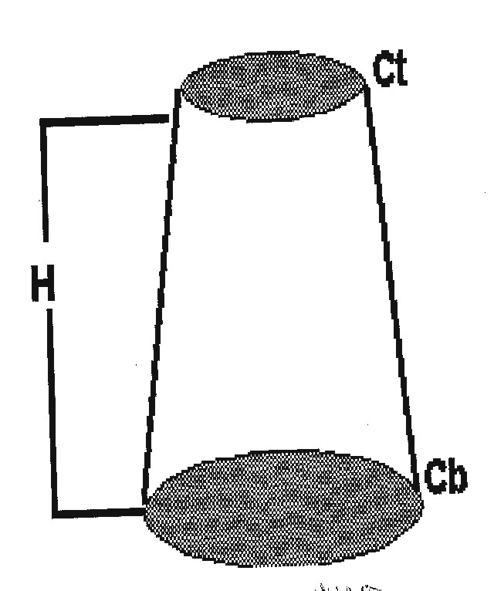
Summed Truncated Cone Volume
An indirect method used to calculate limb volume.
The limb is visualized as a cone.
The circumference of the extremity at a segment together with the length are used to calculate the volume of the segment. A series of segments is then summed for the final volume
V= 1/12 x h (Ct + Cb = c2)
V= volume
h= height
Ct = proximal circumference
Cb= distal circumference
Notes:
The Academy of Lymphatic Studies sells a program that calculates these volumes and compares the affected and unaffected limbs.
https://www.lymphedemastore.com/ViewProducts.aspx?cid=107&Description=CD%27s (educational materials / CDs)

Slide 6
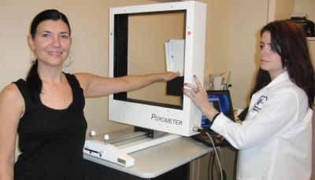
Optoelectric Perometer

Slide 7
No universally accepted diagnostic tool to determine presence of lymphedema
All methods valid and reliable to quantify and monitor LE
Significant variability between devices/measures to allow comparisons
Volumetry and circumferential measures are reliable and highly correlated, but not interchangeable

Slide 8
No universal definition of lymphedema
10% or greater change in limb volume
Greater than 1 cm to 2 cm change from baseline
Greater than 2 cm change from unaffected limb
2 cm increase in 2 consecutive anatomic sites
Greater than 200 mL of volume increase
ACOSOG : 2cm or greater increase over the baseline or greater than 10% increase in circumference of the ipsilateral arm at 10 cm proximal and distal to the lateral epicondyles.
Subjective reports of heaviness, pain

Slide 9
Most women report that they did not receive any counseling or written information from their physicians on signs and symptoms or presence of lymphedema
Paskett, ED Stark N The Breast Journal 6(6) 373-378, 2000

Slide 10
TREATMENT OF LYMPHEDEMA
CDT: Complete Decongestive Therapy
Compression:
Bandaging
Garments
Pumps
Manual Lymph Drainage Massage (MLD)
Decongestive Exercises
Meticulous Skin Care
Avoid Constriction, Overheating, Sunburn, Muscle Strain, Skin breaks when possible, Reduce salt intake, Weight loss if BMI over 25
Notes:
CDT – Hallmark of Lymphedema treatment since the 1970s

Slide 11
COMPLEX DECONGESTIVE PHYSICAL THERAPY: Goals
decongest swollen body part
eliminate fibrotic tissue
avoid reaccumulation of lymph fluid
prevent/eliminate infections
improve immune system function

Slide 12
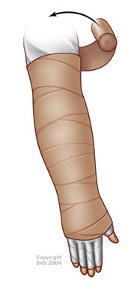
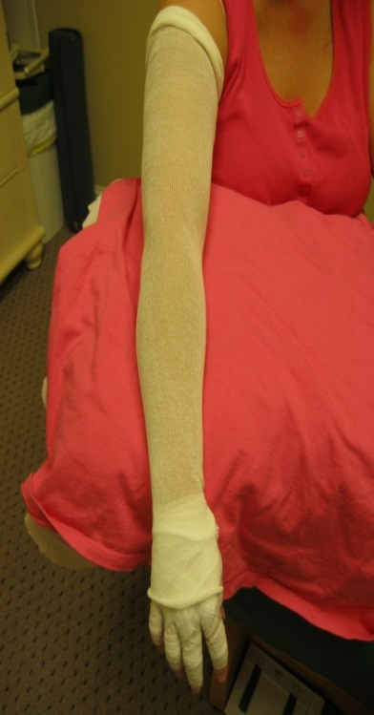
Compression bandaging for moderate to severe lymphedema
Compression bandaging is a systematic application of short stretch bandages.
Uses more bandages distally than proximally which assists the pressure gradient in moving fluid up the arm
Generally worn 23 hours per day in the acute phase and then at night for maintenance
Notes:
Law of LaPlace: If compression is applied, using the same tension throughout, the greatest pressure will exist at the area of smallest radius.
P = T/R: P= pressure, T = tension, R = radius

Slide 13
Compression Effects
Reduces effective ultrafiltration pressure
Increases and accelerates venous and lymphatic drainage
Improves the venous pump function
Softens tissues with fibrotic changes
Notes:
Increases drainage: narrows vessels to accelerate flow (up to 1.5x normal without exercise), reduces lumen of dilated veins with insufficient valves – making some valves sufficient again, pressure gradient in the right direction
Improves venous pump function – with edema, skin loses its elasticity, compression can act in its place, thereby increasing external resistance against the muscle pump so that it can act on the veins and lymphatics
Softens fibrotics tissues – like in burns, compression can soften scar tissue; foam can be added to get compression at lymphostatic fibrosis areas

Slide 14
Lymphedema Bandages vs. ACE Wrap
Short Stretch Bandages
ACE Wrap (Long Stretch)
60% Extensibility
High working pressure / Resistance
Temporary pressure
Increased movement of venous and lymphatic fluids
Low resting pressure
Permanent pressure
Low risk of tissue damage
140% Extensibility
Low working pressure
Minimal decongestive effect
High resting pressure
Compresses superficial venous and lymphatic vessels
Risk of tourniquet effect and tissue damage
Notes:
Working Pressure: the (temporary) resistance the bandage gives to working muscles. This active working pressure results in an increase of tissue pressure and the venous and lymphatic vessels in the superficial and in the deep systems are compressed. The return of fluids within these vessel systems is improved.
The lower the elasticity of a compression bandage, the higher the working pressure.

Slide 15
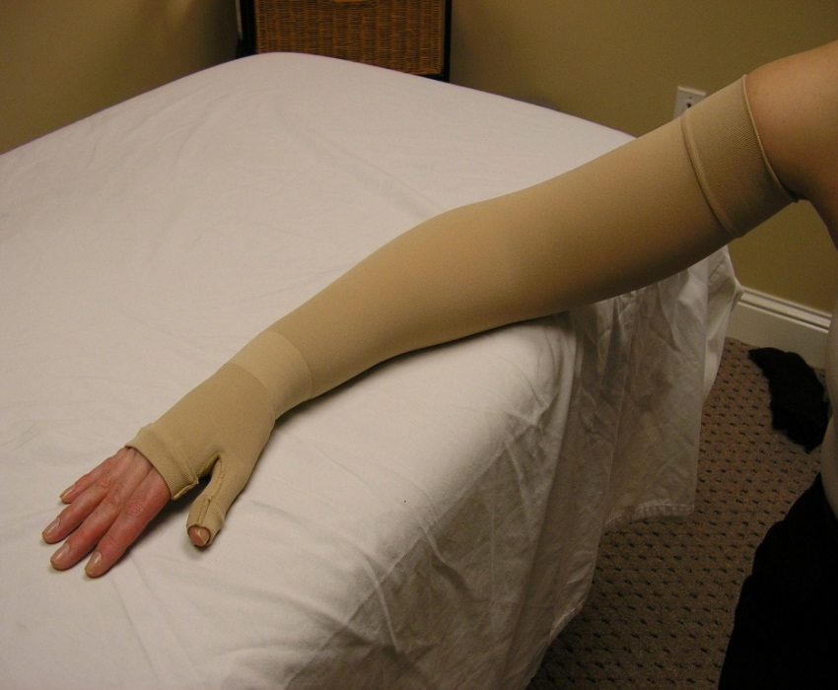
Compression Garments
The increased pressure exerted against the skin and tissues decrease filtration of lymph fluid out of the arteries and protects the lymph vessels from stretching
Bertelli reported statistically significant reduction in edema in patients wearing garments 8 hours per day
Superior reduction occurred in women without significant weight gain following treatment
Bertelli G et al: Surg Gynecol Obstet 175 (5) 455-60. (1992)
Notes:
The traditional CDT teaching is that compression garments can help reduce refilling of a decongested limb, but cannot, by themselves, reduce swelling

Slide 16
Stout Gergich, N.L., Pfalzer , N. L., McGarvey, C., Springer, B., Gerber, L. H. and Soballe, P. (2008), Preoperative assessment enables the early diagnosis and successful treatment of lymphedema. Cancer, 112: 2809–2819.
Pre-Operative Assessment of Breast Cancer Patients by Physical Therapists Improves Lymphedema Diagnosis and treatment
All study participants were monitored pre-op and at one month post-surgery and at three-month intervals thereafter for one year even if they exhibited no swelling. Using both the pre- and post-operative assessments enabled investigators to diagnose lymphedema before it became visible
The authors demonstrated the effectiveness of a surveillance program to successfully detect and treat lymphedema
Detection and management of lymphedema at early stages may prevent the condition from progressing
Once lymphedema was diagnosed (3%) it was managed using a light-grade compression sleeve and gauntlet for daily wear for 4 to 6 weeks and then PRN.

Slide 17
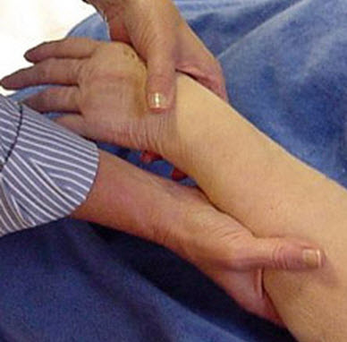
Manual Lymphatic Drainage (MLD)
Specialized massage stimulates lymph flow
Four basic strokes based on Vodder: “stationary circle”, “pump”, “rotary”, and “scoop”
Strokes have a working phase and a resting phase
Rhythmic: each phase about 1 second
Redirects excess fluid to healthy lymphatic vessels
Healthy lymphatic territories have been prepared prior to MLD of the affected region
Notes:
Working phase – stretch stimulus is applied to the subcutaneous tissues, resulting in the manipulation of anchoring filaments of lymph capillaries and the smooth musculature in the wall of lymph angions. Light directional pressure serves to move lymph fluid in the appropriate direction. Pressure should be just enough to stretch the subQ tissues against the underlying fascia.
Resting phase: elasticity of the skin moves therapist’s hand passively back to the starting position / lymph vessels absorb fluid from interstitium
In Lymphedema: the goal is reroute the lymph fluid around blocked areas.

Slide 18
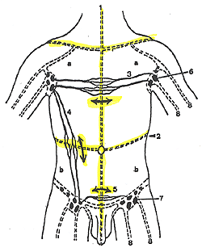
Lymphatic Territories and Anastomoses

Slide 19
Manual Lymphatic Drainage Effects:
Increases lymph production
Increases lymph vessel contractility
Relieves congestion
Removes waste products from tissues
Stimulates all body fluids to flow
Breaks up fibrosis
Tissues Which Are Drained by Massage or Pumping MUST BE COMPRESSED TO PREVENT RE-FILLING!

Slide 20
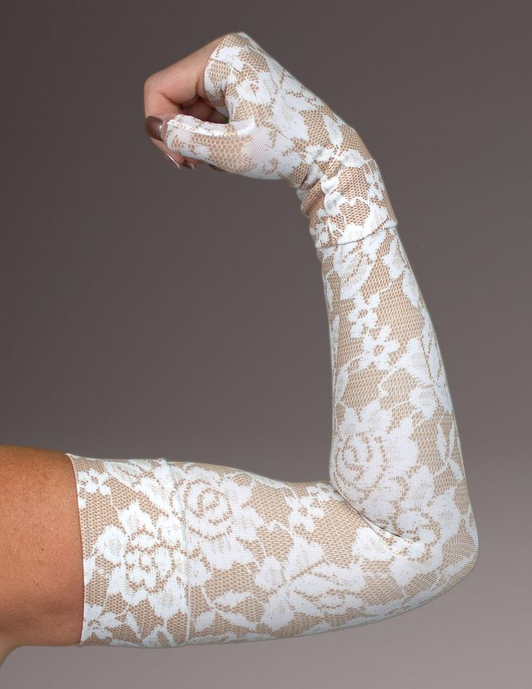
Decongestive Exercises
Traditional CLT teaching about exercise is based on physiology
During exercise, blood flow increases; therefore, there is an increase in filtration into the interstitium and an increase in the lymphatic load
Compression during exercise
Increases effectiveness of muscle pump
Limits filtration out of the arterioles into the interstitium
Sequential Pump – distal to proximal
Deep Breathing
Stimulate Cisterna Chyli
Limit overexertion
Notes:
CLT training advocates self-MLD, warm-up and deep breathing prior to exercising and stretching

Slide 21
Lymphedema management: the evidence
Compression bandaging with and without manual lymph drainage
38 pts with breast cancer and lymphedema
week 1, 2: bandaging alone
week 3: pts divided into bandaging with and without manual lymph drainage
Results:
significant volume reductions in week 1, 2
no significant difference in volume reduction between groups in wk 3
but percentage volume reduction > in CB/MLD group
Johansson K, et al. Lymphology 1999 Sep;32(3):103-10

Slide 22
MLD and Compression Bandaging
In a prospective RCT by McNeely researchers looked at reduction of arm volume from MLD in combination with CB alone
No significant difference seen between the groups
McNeely ML et al.Breast Cancer research and Treatment, 86(2):95-106 (2004)

Slide 23
Manual Lymph Drainage (MLD)
A Cochrane review of 195 scientific papers found MLD provided no benefit at any point over use of the sleeve or bandages alone
There are limited positive applications for MLD in cases of mild lymphedema or fibrosis.
Badger C, et al.Physical Therapies for reducing and Controlling Lymphoedema of the limbs. Cochrane Libr, 2006 (4)

Slide 24
RCT: CDT vs. Compression Garments
103 women; 6 institutions
All had previously been treated for LE and had >10% volume difference between arms at the time of the study
Control group used compression garments only
Experimental group got daily MLD + bandaging followed by compression garments
RESULTS: “trial was unable to demonstrate a significant improvement in LE with CDT compared to a more conservative approach”
Dayes, IS, et Randomized trail of decongestive lymphatic therapy for the treatment of lymphedema in women with BC.. J Clin Oncol, 2013 Oct 20; 31(30)
Notes:
Volumes were calculated from circumferential measures.
Primary outcome was percent reduction in excess arm volume from baseline to 6 weeks.

Slide 25
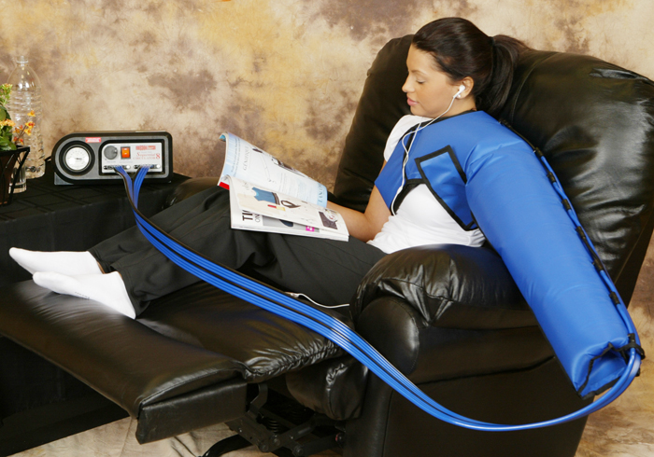
Compression Pump
Guidelines for use and selection are unclear
Some studies show pumps ineffective other studies show a statistically significant reduction in edema when used consistently in a 48 hour period.
Rinehart-Ayres M, Rehab Oncol 25 (1): 25, 2007

Slide 26
Pneumatic Compression Pump
Pros
Paid by insurance
Easy to use
Usage recommendations range from 1 -12 hours daily
Cons
Time consuming and cumbersome
Ignores lymph physiology
Risk of trauma to initial lymphatics
Risk of fibrous cuff

Slide 27
TP Guidelines for Pump Utilization
Treatment with bandaging, exercise and lymphedema massage has been tried and patient has plateaued
Bandaging is refused or not feasible due to co-morbidities
Pump is tried daily in the clinic for one hour with pre and post volumetric measures taken
If pump is effective in reducing arm circumference or volume, patient is provided a loaner pump to try for 1-2 weeks of self-management at home

Slide 28
TP Sequential Pump Protocol
Sequential multi-chambered pump (4, 8 or 12 chambers)
Chambers have valves allowing each chamber to remain inflated as the subsequent chamber fills, when all chambers are filled they deflate.
Compression set at 40-50 mm Hg (must be 20 mm Hg below diastolic BP)
Pump for one hour 1-2 times per day

Slide 29
Recent Evidence about Pneumatic Compression Treatment for Lymphedema
2 new studies out of Warsaw, Poland were presented at the 2014 NLN Conference
The effects of 3 years of Pneumatic Compression
IPC takes over the transport function of lymphatics by squeezing edema fluid to regions with normal drainage
No formation of a fibrous cuff
IPC enhances the formation of tissue fluid channels
Compression of limb lymphedema tissues leads to formation of channels within the tissues as pathways for the evacuation of edema fluid
Notes:
IPC = intermittent pneumatic compression

Slide 30
Arm Elevation
There is no data on the efficacy of elevation in the treatment of lymphedema
Recommended guidelines are not available/published
Elevation thought to reduce the intravascular pressure allowing lymph to flow freer
Brennan, MJ et al: Cancer 83 (12) 2821, 1998.

Slide 31
Exercise and Lymphedema
Old Rationale
New Evidence
Historically, heavy resistance training was discouraged in women with lymphedema because it increased blood flow, adding to the workload of the lymph system and overwhelming a compromised system
Exercise increases muscle mass and the muscular pump which facilitates movement of lymph fluid
Exercise also helps to combat obesity which is a potent risk factor for lymphedema

Slide 32
Challenging Teachings about Exercise Effect of Upper Extremity Exercise on Secondary Lymphedema in Breast Cancer Patients: A Pilot Study McKenzie DC. J Clin Onc. 2003
Began 1996 at the University of British Columbia
Don McKenzie – sports medicine physician who was studying cardiorespiratory fitness of BC survivors
Strove to dispel the myth that women with BC should refrain from repetitive upper body exercise for fear of lymphedema
“Abreast-In-A-Boat” – 1st all BC survivors team
Training: slow, progressive weight and aerobic training
No new cases of lymphedema; no worsening of existing cases
Notes:
In the cardio study, many BC survivors had anecdotal stories about the “don’ts” they had been told after treatment. Though well intended, there was no published research to support this information.
Why dragon boating? Strenuous, repetitive, upper body exercise that increases flexibility, aerobic capacity and strength. Also, allows working with large group of women simultaneously. Projects a visible, positive message to BC survivors. Builds harmony, togetherness, teamwork. It’s fun!! Vancouver has an annual Dragon Boat Festival.

Slide 33
The effect of gentle arm exercise and deep breathing on secondary arm lymphedema. Moseley AL, Piller NB. Lymphology. 2005.
Subjects: 38 women participants
Intervention: 10 minutes of standardized arm exercises and deep breathing
Measures: limb volume and perception
Results: decreased volume after ex. (5.8%), reductions persisted at 1 hour (5.3%), 24 hours (4.3%) and 1 week (3.5%) follow-ups
A cohort of 24 women continued the study for 1 month
10 mins. am and pm led to volume decreases persisting for 1 month.
After one month volume reduction was 9.0%
Notes:
Gentle exercise + deep breathing. (think yoga)
Directly after exercise: reduction in arm volume of 52mls (5.8%)
After 30 minutes: reduction was 50 mls (5.3%)
After 24 hours: reduction was 46 mls (4.3%)
After 1 week: reduction was 33mls (3.5%)
A cohort of 24 women continued the study for 1 month. These women did the 10 minutes gentle exercise and deep breathing program each morning and each evening.
After 1 month with regular exercise: reduction was 101 mls (9.0%)

Slide 34
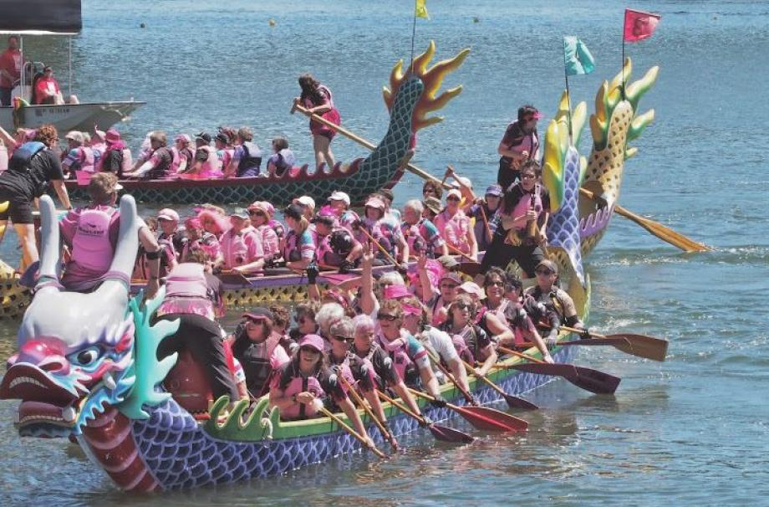
The effect of a whole body ex program and dragon boat training on arm volume in women treated for breast cancer. Lane K, Jesperson D. Eur J Cancer Care. 2005.
16 bc survivors without lymphedema
20 weeks of aerobic and resistance ex
Added dragon boat training at week 8
All women increased in mm. strength
No new cases of lymphedema
Notes:
Aerobic and resistance ex. +dragon boat paddling
Arm circumference and upper body strength were measured at baseline, 8wks and 20 weeks.
Circumference increased bilaterally as the result of increased mm. mass .

Slide 35
Lymphedema and Exercise
No form of physical activity has been associated with new incidents of or exacerbations of lymphedema in the literature.
Ahmed- (2006) weight training
Courneya (2007) aerobic exercise
Lane (2005) resistance training & dragon boat paddling
McKenzie (2003) resistance training and arm ergometer
Sleeve use did not make any difference
McNeely (2009) weight lifting

Slide 36
Evidence-Based Management of Lymphedema
Education re: Condition, Self Management, Infection, Inflammation, Skin Care
Exercise – aerobic and strength training
Compression:
Compression sleeve and glove maintenance and surveillance program for early, mild lymphedema (Gergich, 2008)
Bandaging (wrapping) and/or Compression Sleeve combination for moderate to severe lymphedema (Bertelli G et al, 1992; Badger, 2004)
Weight Loss (if applicable) (Shaw, 2007)
Manual Lymphatic Drainage
Pneumatic Compression Pumping

Slide 37
TurningPoint Breast Cancer Rehabilitation’s Evidence-Based Approach to Lymphedema Management
 | Transient Lymphostasis | Sub-Clinical Lymphedema | Mild Lymphedema (Stage I) | Moderate Lymphedema (Stage II) | Severe Lymphedema (Stage III)
SIGNS and SYMPTOMS | Swelling of arm that occurs soon after surgery (either initial surgery or reconstruction) that resolves with or without treatment. Swelling easily reversible – usually diminishes at night. Note: Typically transient lymphedema is only identified when there is full resolution of swelling and no recurrence. Therefore, transient lymphedema is treated as per sub-clinical or mild lymphedema, depending on volume. | Heaviness, fullness, tingling sensations in affected arm. Affected:Unaffected Volume ratio increased by 3-5% compared to baseline. No obvious visible swelling, but there may be palpable soft tissue evidence of swelling. | Mild visible swelling in hand and/or arm. Swelling easily reversible – usually diminishes at night. Affected:Unaffected Volume ratio increased by 3-10% compared to baseline. | Non-reversible. Could be reversible with mild tissue changes Affected:Unaffected Volume ratio increased by 11-20% compared to baseline. Decreased visibility of veins. Visible swelling with fullness of the elbow, forearm or wrist contours. Increases skin thickness with or without hand swelling | Typically non-reversible. Affected:Unaffected Volume ratio increased by greater than 20% compared to baseline. Skin changes with adhesions and fibrosis, skin may be indurated and dry.
SHORT-TERM MANAGEMENT APPROACH | Education: • Skin & injury precautions – avoid infection and strain/sprain. • Signs & symptoms of lymphedema progression. • Nutrition and hydration issues. • Maintenance of ideal body weight. • Recommendations for travel, including air travel. Compression: Class II compression sleeve during waking hours, including while performing athletics. + / - gauntlet per judgment. Exercise: Aerobic and upper body exercise resisted exercise. Weight management if applicable. Treat Limitation in upper extremity range of motion and/or strength. | Education: See Transient. Compression: Class II compression sleeve (OTC or custom as needed) for 2-3 weeks during waking hours until reduced, then as needed if swelling recurs. + / - gauntlet per judgment. MLD: Use with discretion ensuing that addition of MLD produces measureable change. Exercise: Aerobic & upper body resisted exercise. Weight Management if applicable. Treat limitation in upper extremity ROM and strength. | See Sub-Clinical. Education: Aerobic & upper body resisted exercise. | Education: See Transient. Compression: Course of lymphedema bandaging 23 hrs/day for 2-4 weeks until volume reduced and plateaued. MLD: Use with discretion ensuring that addition of MLD produces measureable change. Exercise: Aerobic and upper body ROM and resisted exercise. Weight Management if applicable. Treat limitation in upper extremity ROM and/or strength. | Education: See Transient. Compression: Course of lymphedema bandaging 23 hours/day for 2-4 weeks until volume reduced and plateaued. MLD: Not indicated. Soft Tissue Techniques: Focus on areas of tissue changes to address fibrosis and adhesions. Exercise: Aerobic and upper body ROM and resisted exercise. Weight Management: if applicable. Treat limitation in upper extremity ROM and/or strength. Trial of pump if indicated by lack of progression with above approaches.
LONG-TERM MANAGEMENT APPROACH | Surveillance to determine lymphostasis vs. lymphedema. | Compression: Sleeve as needed for visible or measureable swelling. Surveillance and adjustment of management plan as needed. | Compression: Sleeve as needed or measureable swelling. Sleeve as determined with PT for athletics or travel. Surveillance and adjustment of management plan as needed. | Compression: As needed to maintain lymphedema at goal volume. This may be a combination of compression sleeve and/or intermittent bandaging. Sleeve as determined with PT for athletics or travel. Continued exercise for weight maintenance/reduction. Surveillance and adjustment of management plan as needed. | Compression: As needed to maintain lymphedema at goal volume. May be a combination of compression sleeve and/or intermittent bandaging. Local treatment with compression for areas of fibrosis. Continued exercise for weight maintenance / reduction. Surveillance & adjustment of management plan as needed.
Notes:
ISL Staging (International Society of Lymphology)

Slide 38
TurningPoint Stages of Lymphedema
Transient Lymphostasis
Swelling that occurs soon after surgery
Swelling is easily reversible; usually diminishes overnight
Only truly identified if there is full resolution
Sub-clinical Lymphedema
Heaviness, fullness, tingling sensations in affected arm
Affected arm is 3-5% larger than baseline (or unaffected arm)
No obvious visible swelling
Mild Lymphedema (Stage I)
Mild visible swelling in hand or arm, may still diminish at night
Affected arm is 3-10% larger than baseline (or unaffected arm)
Notes:
ISL Staging (International Society of Lymphology)

Slide 39
TurningPoint Stages of Lymphedema
Moderate Lymphedema (Stage II)
Non-reversible; Could be reversible with mild tissue changes
Affected arm is 11-20% larger than baseline (or unaffected arm)
Decreased visibility of veins
Visible swelling with fullness of elbow, forearm or wrist contours
Increased skin thickness
+/- hand swelling
Severe Lymphedema (Stage III)
Typically non–reversible
Affected arm is >20% larger than baseline (or unaffected arm)
Skin changes with adhesions and fibrosis
Skin may be indurated and dry

Slide 40
Lymphedema Treatment: Education
The same concepts for all stages of lymphedema
Basic lymphatic anatomy & physiology
Skin & Injury Precautions – avoid infection, injury
Cellulitis
Signs & Symptoms of LE progression
Nutrition / Hydration Issues
Maintenance of ideal body weight
Benefits of exercise
Recommendations for air travel

Slide 41
Lymphedema Treatment: Sub-Clinical and Mild Lymphedema (Stage I)
Compression: Class II compression sleeve – OTC or custom
2-3 weeks during waking hours (or until volumes are reduced)
+/- Gauntlet per judgment
Manual Lymphatic Drainage
Used with discretion – ensuring that addition of MLD produces measureable changes
Exercise
Aerobic and upper body resisted exercise
Treat limitations in upper extremity ROM and strength
Long-term
Sleeve, as needed per return of symptoms or swelling
Surveillance

Slide 42
Lymphedema Treatment: Moderate Lymphedema (Stage II)
Compression
Course of bandaging, 23 hrs/day, for 2-4 weeks until volumes reduced/plateau
MLD: used with discretion, ensuring that it produces a measureable change
Exercise: Aerobic and upper body resistance
Treat limitation in upper extremity ROM or strength
Long-term management: To maintain LE at goal volume
Compression – sleeve and/or bandaging or night garments, as needed.
Sleeve as determined with PT for athletics or travel.
Surveillance and adjustment of plan as needed

Slide 43
Lymphedema Treatment: Severe Lymphedema (Stage III)
Compression
Course of bandaging, 23 hrs/day, for 2-4 weeks until volumes reduced/plateau
MLD: not indicated
Soft Tissue Techniques: address fibrosis and adhesions
Exercise: Aerobic and upper body resistance
Treat limitation in upper extremity ROM or strength
Trial of Pump if indicated by lack of progress with the above
Long-term management: To maintain LE at goal volume
Compression – sleeve and/or bandaging or night garments, as needed.
Local treatment with compression for areas of fibrosis.
Surveillance and adjustment of plan as needed

Slide 44
Model Summary
individualized education related to lymphedema risk and risk reduction
assessment of baseline volume measures and ongoing surveillance to facilitate early lymphedema detection
aerobic and upper extremity range of motion and progressive resistance exercise for all women at risk for and with lymphedema
lymphedema management plan that is based on severity and stage of lymphedema, measures of impairment and functional outcome
development of a long-term management plan that meets women’s quality of life needs

Slide 45
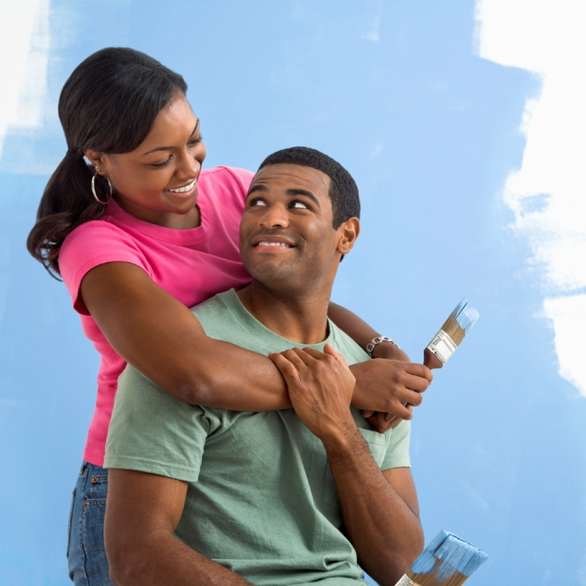
Women who are at risk for lymphedema or have lymphedema can have excellent quality of life!

